Slide 1

Liabilities vs. Responsibilities, Covenants, Warranty, Guarantee, and Indemnification
Understanding Key Legal Concepts

Slide 2

Introduction
In legal and business contexts, terms like liability, responsibility, covenant, warranty, guarantee, and indemnification are often used interchangeably, but they represent different obligations. This presentation explains the key differences between these concepts.

Slide 3
Liability
Liability refers to a legal obligation to compensate for harm or loss caused by one's actions or omissions. It involves monetary damages and can arise from legal breaches, torts, or contract violations.
Examples include:
- Strict Liability: Without fault (e.g., dangerous activities)
- Vicarious Liability: One party held responsible for another's actions (e.g., employer for employee)
- Limited Liability: Restricting liability to invested capital (e.g., in corporations)

Slide 4
Responsibility
Responsibility refers to the duty to perform specific tasks or actions. It does not necessarily entail legal obligations to compensate for harm. Responsibilities can be moral, contractual, or organizational.
- Unlike liability, responsibility relates to performance and actions rather than legal consequences.

Slide 5
Covenant
A covenant is a formal promise or agreement within a contract, binding a party to do or refrain from doing something. It is typically found in legal documents like real estate contracts or financial agreements.
- Affirmative Covenant: Requires action (e.g., maintain insurance)
- Negative Covenant: Prohibits actions (e.g., limits borrowing)

Slide 6
Warranty
A warranty is an assurance or promise regarding the quality or condition of goods or services at the time of the contract.
- Express Warranty: Explicitly stated in the contract
- Implied Warranty: Automatically applied under law
Breach of warranty can entitle the buyer to remedies such as repair, replacement, or compensation.

Slide 7
Guarantee
A guarantee is a contractual promise where one party (the guarantor) ensures that another party's obligations will be fulfilled if they fail to do so. It often involves financial or performance commitments.
- Personal Guarantee: Individual guarantees performance or payment
- Corporate Guarantee: Company guarantees another's obligations

Slide 8
Indemnification
Indemnification is a contractual obligation where one party agrees to compensate another for losses, damages, or third-party claims. It serves as a risk-shifting mechanism, protecting the indemnitee from liability.
- Indemnification can cover third-party claims, direct losses, or include hold-harmless provisions.

Slide 9
Key Differences
Liability vs. Indemnification: Liability requires compensation for harm, while indemnification shifts the burden of payment.
Warranty vs. Guarantee: A warranty is a promise about product quality, while a guarantee ensures obligations are fulfilled.
Covenant vs. Responsibility: A covenant is a contractual promise, while responsibility involves duties without financial penalties.

Slide 10
Tort Law and Contractual Drafting Challenges
Understanding Tort Law, Drafting Complexities, and Civil Law Differences

Slide 11
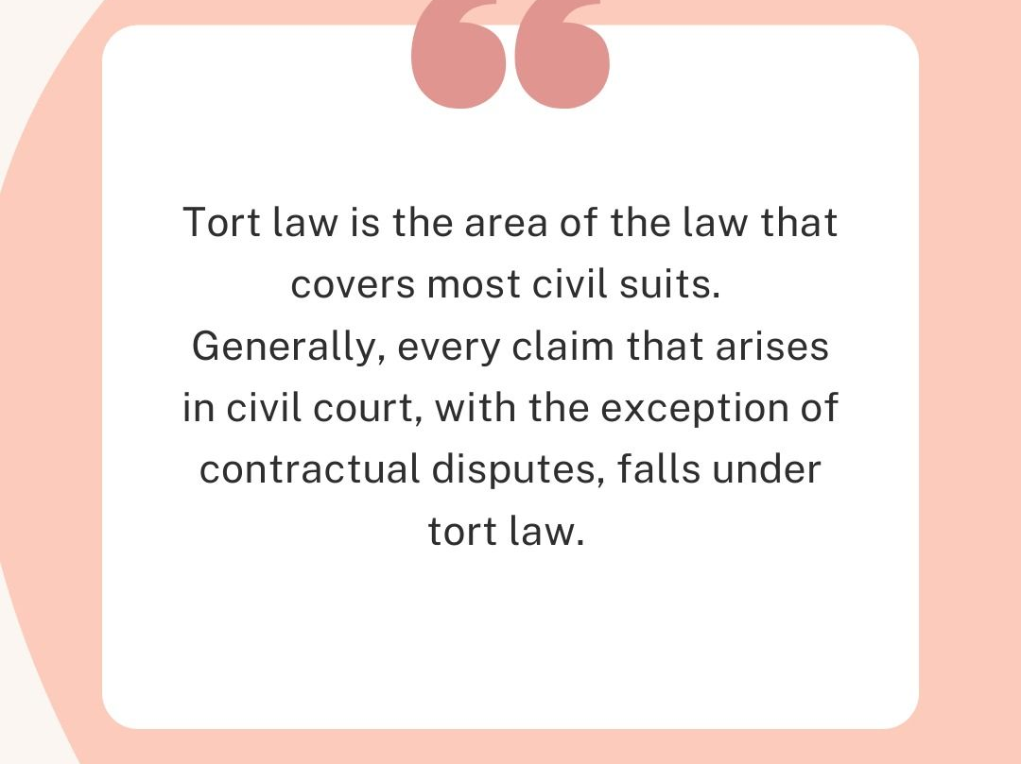

Slide 12
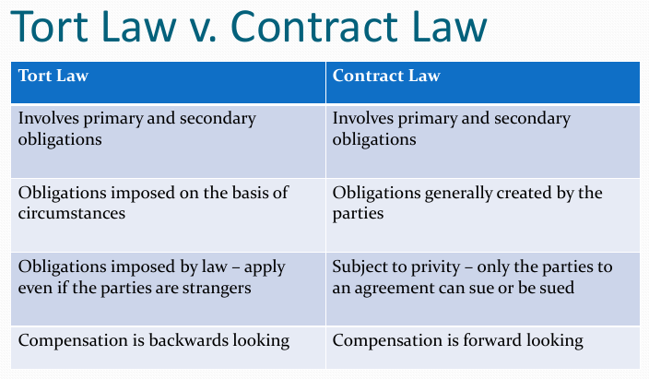

Slide 13
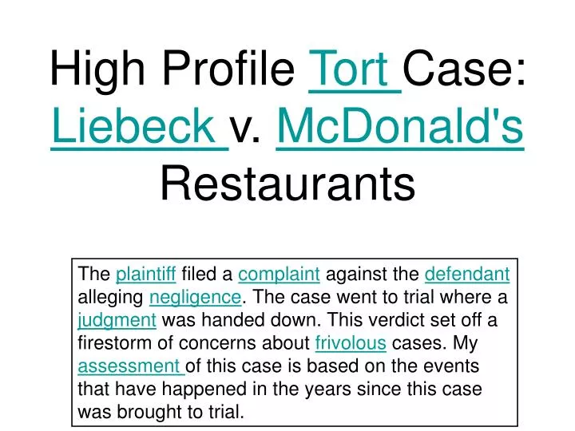
Notes:
https://www.youtube.com/watch?v=pCkL9UlmCOE

Slide 14
Introduction to Tort Law
Key Principles of Tort Law:
• Duty of care
• Breach
• Causation
• Damages

Slide 15
Challenges in Drafting Clauses Around Tort Law
Key Challenges:
• Scope of Liability
• Unforeseen Events
• Overlap with Contractual Obligations
• Varying Jurisdictional Interpretations

Slide 16
Why No Equivalent in Civil Law?
Key Reasons:
• Codified Approach
• Unified Liability Structure
• Less Reliance on Precedent

Slide 17
Conclusion
Key Takeaways:
• Tort law brings unique challenges in contractual drafting.
• Tort and contract law operate independently in common law systems.
• Civil law systems offer a unified, codified approach to liability.
• Understanding these differences is crucial for legal drafting.

