Slide 1



Contract
Drafting in English

Slide 2
Introduction
Let’s start with an overview of the course structure:
We will meet online every Monday and Thursday for two hours, with an in-person workshop at the end of the course.
You will have access to additional materials, including specialized dictionaries and a repository of bilingual templates.
There will be practical exercises in each session to help reinforce your learning.
Our primary goal is to enable you to draft contracts accurately in English, covering essential clauses, terminology, and drafting techniques to meet the needs of both local and international contexts.

Slide 3
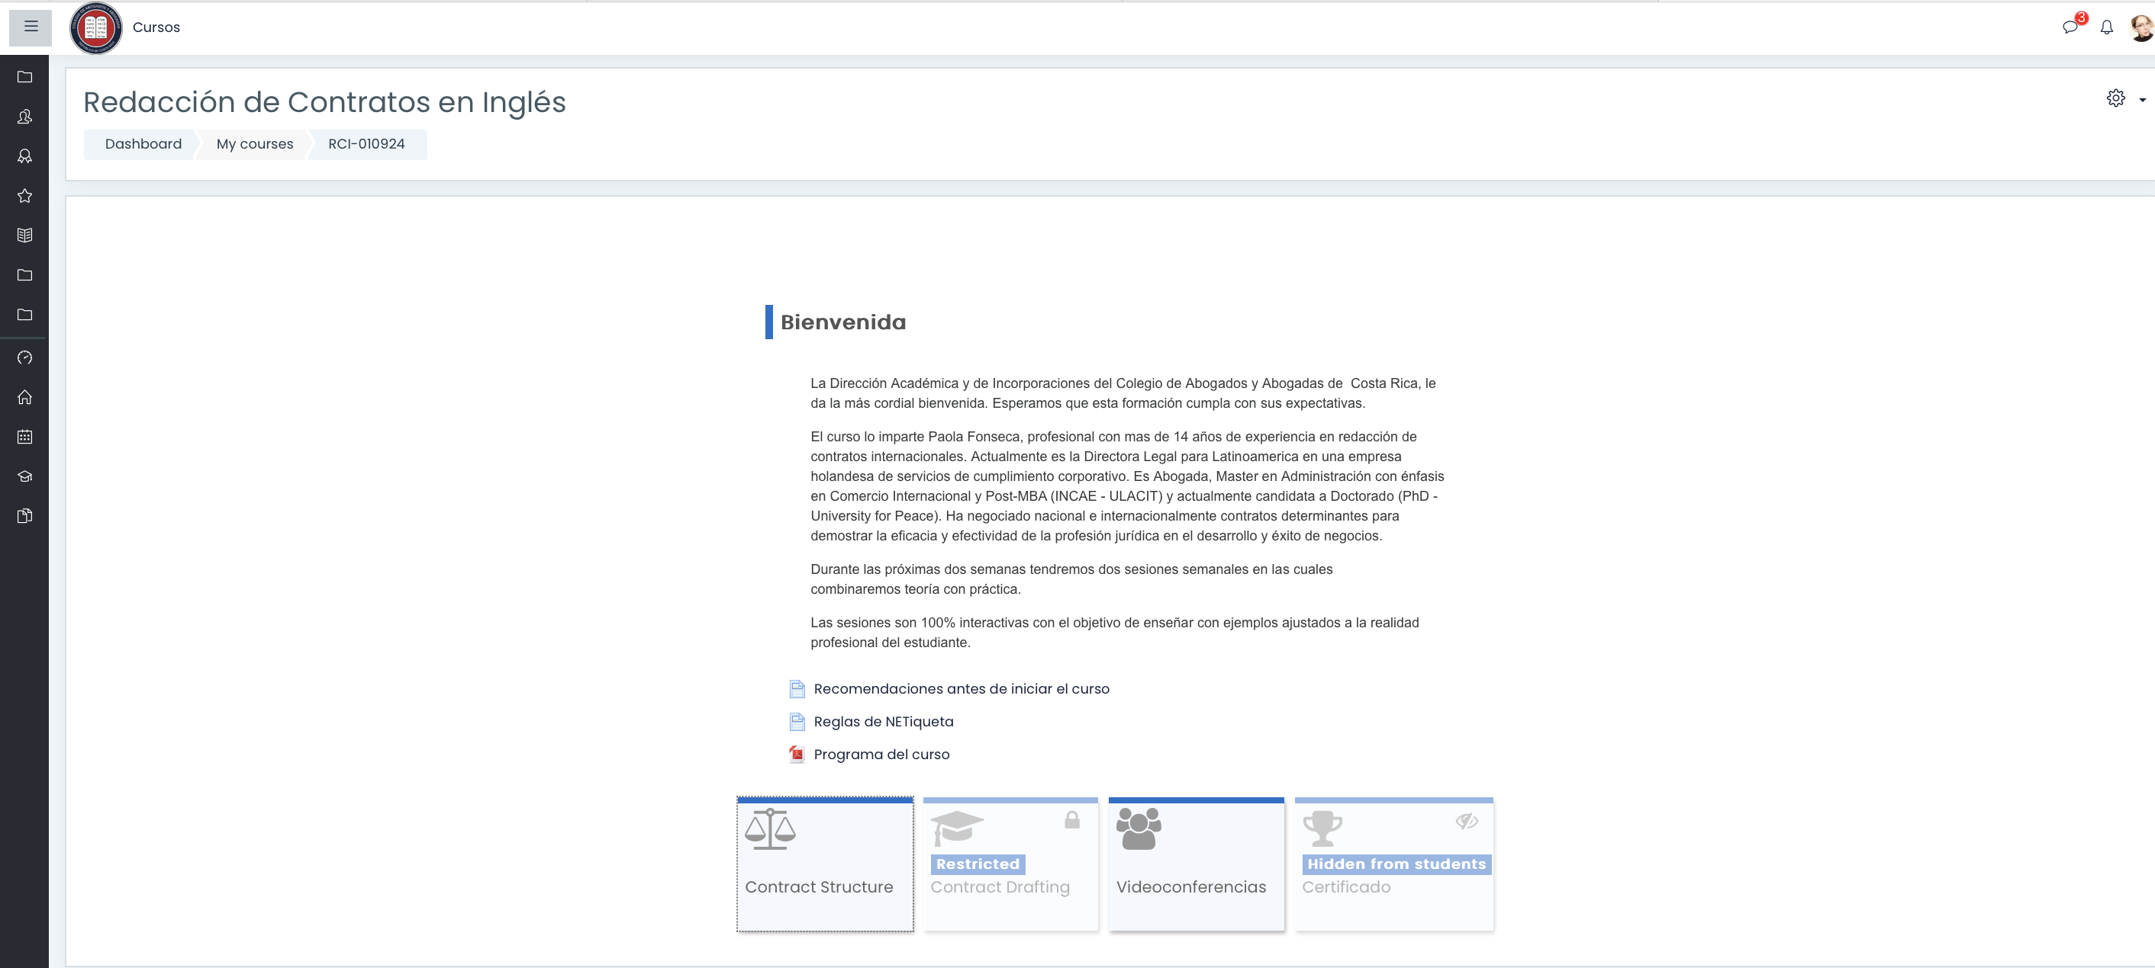

Slide 4
Examples of Poor vs. Proper Contract Drafting:

Slide 5
Example 1: Ambiguity in Terms
Proper Drafting: "The supplier must deliver the products within 10 business days from the date of this agreement."
Improvement: This version is clear, specific, and leaves no room for ambiguity, reducing the likelihood of disputes.
Issue: The term "soon" is vague and open to interpretation, which can lead to disputes over timing.
Poor Drafting: "The supplier must deliver the products soon."

Slide 6
Example 2: Unclear Liability Clauses
Proper Drafting: "The contractor's liability for damages arising out of this agreement shall be limited to direct damages not exceeding the total contract value."
Improvement: This version limits the contractor's liability to a manageable amount and to specific types of damages, providing more protection for the contractor.
Issue: This broad clause could expose the contractor to unlimited liability, which may be unfair or unmanageable.
Poor Drafting: "The contractor shall be liable for all damages."

Slide 7
Example 3: Inadequate Governing Law Clause
Issue: The term "relevant jurisdiction" is not defined, leading to potential conflicts over which jurisdiction's laws apply.
Proper Drafting: "This contract shall be governed by and construed in accordance with the laws of the State of New York, United States."
Improvement: This version clearly identifies the governing law, reducing the risk of legal disputes over jurisdiction.
Poor Drafting: "This contract is subject to the laws of the relevant jurisdiction."

Slide 8
Example 4: Missing Severability Clause
Proper Drafting: "If any provision of this agreement is found to be invalid or unenforceable, the remaining provisions shall remain in full force and effect."
Issue: If a court finds one part of the contract invalid, it may render the entire contract unenforceable.
Improvement: This clause ensures that the contract remains enforceable even if part of it is invalidated.
Poor Drafting: No severability clause included.

Slide 9
Example 5: Overly Restrictive Covenant
Proper Drafting: "The employee shall not work for any competitor within a 50-mile radius for one year after leaving the company."
Improvement: This version is more reasonable in scope and duration, making it more likely to be enforceable.
Poor Drafting: "The employee shall not work for any competitor for five years after leaving the company."
Issue: This non-compete clause is excessively restrictive and may not be enforceable.

Slide 10
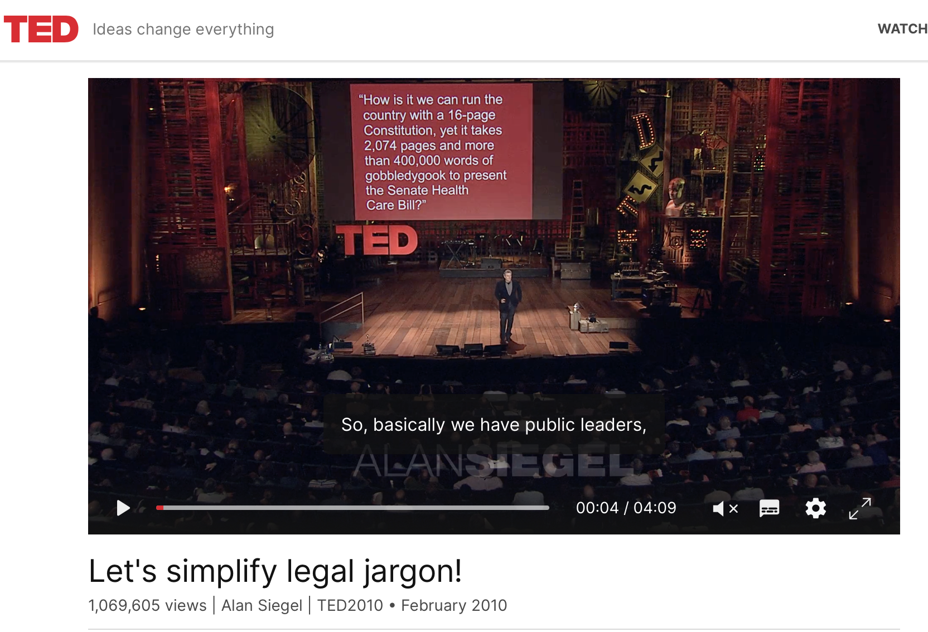
Notes:
https://www.ted.com/talks/alan_siegel_let_s_simplify_legal_jargon?subtitle=en&geo=es

Slide 11
Contract Drafting in English in Costa Rica´s Context

Slide 12
“Contract drafting in English is becoming increasingly important for Costa Rican lawyers due to globalization and the growth of cross-border transactions. Many clients, especially international companies, prefer English contracts as they are often required in multinational business environments.
the nuances of legal English is vital, particularly the differences between American and British legal terminology. For instance:
In American contracts, you might encounter the term ‘warranties,’ while in British contracts, it’s often referred to as ‘undertakings.’
A ‘lease’ in the U.S. context may sometimes be called a ‘tenancy agreement’ in the U.K.
Awareness of these distinctions helps in ensuring that contracts are enforceable and understood in the appropriate jurisdiction. Throughout this course, we will focus on identifying and mastering these differences.” Civil Law vs. Common Law Contracts: Contracts in civil law jurisdictions are usually shorter and less detailed because they rely heavily on the civil code, which provides general rules and fills in gaps. In contrast, common law contracts are longer and more comprehensive, as they need to explicitly outline every obligation, term, and remedy due to the system’s reliance on case law and the "four corners" rule. Civil law focuses on good faith and statutory provisions, while common law emphasizes freedom of contract and strict interpretation of written terms.

Slide 13
Terms of Reference

Slide 14
Herein
Hereinafter
Hereof
Hereto
Hereunder
Hereby
Therein
Thereof
Thereto
Thereunder
Thereafter
Whereof
Wherein
Whereas
Witnesseth
Notwithstanding

Slide 15
Modal
Verbs

Slide 16
Could:
Definition: Indicates possibility or potential.
Example: "The supplier could deliver the goods by the end of the month."
Usage in Agreements: Not typically strong enough for binding obligations, as it only suggests what might happen under certain circumstances.

Slide 17
Should:
Definition: Implies a recommendation or expectation, but not an obligation.
Example: "The parties should resolve disputes amicably."
Usage in Agreements: Suitable for advisory or non-binding statements, but lacks the enforceability required for strict contractual obligations.

Slide 18
Would:
Definition: Used to express conditional actions or politeness.
Example: "The company would agree to extend the deadline if the client requested it."
Usage in Agreements: Often used in hypothetical or conditional scenarios, but not ideal for creating enforceable commitments.

Slide 19
Will:
Definition: Expresses a firm commitment or obligation.
Example: "The buyer will pay the full purchase price by the due date."
Usage in Agreements: The strongest and most appropriate term for binding commitments. "Will" is used to create clear, enforceable obligations that the parties are legally required to fulfill.

Slide 20
Contract
Structure

Slide 21
Parties:
Identifies the individuals or entities entering into the agreement.

Slide 22
Recitals:
Provides the background or reasons for the agreement.

Slide 23
Considerandos:
Translation of ¨Recitals¨

Slide 24
Consideration:
A crucial component of any contract, "consideration" refers to what each party is offering to the other. It can be a payment, a service, or even a promise to perform (or refrain from) a certain action.
Example: In a sales contract, the buyer's consideration is the payment, and the seller's consideration is the delivery of the goods.

Slide 25
Definitions:
Clarifies key terms used throughout the contract to avoid ambiguity.

Slide 26
Boilerplate Clauses: Standardized clauses commonly included in contracts to address general issues. These are essential for ensuring the agreement is comprehensive and legally enforceable.

Slide 27
Boilerplate Clauses:
Cláusulas Estándar

Slide 28
    Entire Agreement: Ensures that the written contract represents the complete and final agreement between the parties, overriding any previous agreements or understandings.
    Governing Law or Applicable Law: Specifies which jurisdiction's laws will govern the agreement.
    Severability: (Divisibilidad)Allows the rest of the contract to remain in effect even if one part is found to be unenforceable.
    Force Majeure: Excuses a party from fulfilling contractual obligations due to events beyond their control, like natural disasters or wars.
Boilerplate Clauses:

Slide 29
Using [-] and (-) in Contract Drafting:

Slide 30
Purpose:
Used to indicate missing data that needs to be filled in later. This placeholder ensures that all necessary information is provided before finalizing the contract.

Slide 31
Example:
"This agreement is made on the [-] day of [-], 20[-] between [Name of Party A] and [Name of Party B]."

Slide 32
Explanation: The blanks are placeholders for the date and the names of the parties, which will be filled in before the contract is signed.

Slide 33
Purpose:
Used to explain or define specific data within the contract. This helps clarify the terms and ensure that both parties understand the specific details being referenced.

Slide 34
Example:
"The term 'Confidential Information' includes, but is not limited to, trade secrets, business plans, customer lists, and proprietary data (including software code, algorithms, and system designs)."

Slide 35
Explanation:
The parentheses provide additional information that clarifies what is included under "Confidential Information."

